Slide 1
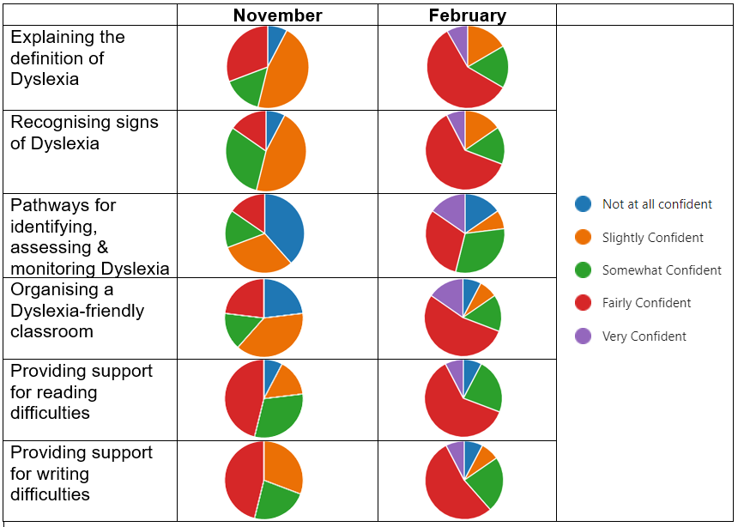
How Can I Increase Confidence in my Colleagues to Support Dyslexia and Literacy Difficulties Within their Classrooms?
Michelle Simpson
Enquiry Overview and Aims
The aim of my project was to evaluate my colleagues’ understanding of Dyslexia and how they felt about supporting their learners and evaluate how this could be increased through sharing of resources and training.
I shared a questionnaire asking them to scale their confidence in certain areas.
I graphed the data and reflected on it with my headteacher. We identified areas that required improvement and decided that information sharing about Dyslexia and how to support learners with Dyslexia was vital.
Information about the definition of dyslexia, referral pathways, support strategies, and resources was shared at staff meetings and inset days and dyslexia-friendly materials were created and shared across the school.
The graphs below show the results of the confidence questionnaire prior to, and following, my inputs.
Collaboration and Impact
Resources have been shared and a dyslexia-friendly approach to displays, and teaching practice has been agreed for the following sessions to provide a consistent and inclusive approach.
The data shows that staff are now more confident supporting their learners with reading and writing difficulties. This will hopefully lead to more effective identification and support for our learners. Teachers who feel more competent in supporting literacy difficulties tend to have more positive attitudes towards teaching students with dyslexia and this creates a more positive learning situation for the pupils.
My Professional Learning Journey
Meeting the needs of learners has always been a priority of mine and I wanted to provide my colleagues with information, ideas, and resources they could access to help them feel more confident in supporting the learners in their class.
My teaching colleagues engaged fully with this project and were very complimentary about the support offered. My management team also supported my enquiry.
I am more confident directing my own learning towards developing teaching practices that supports the needs of my learners and my colleagues that work with them.
Next Steps
Following conversations with my headteacher, I have taken on a supporting role for my colleagues, having opportunities to share my own training and development with them.
Going forward, we hope to continue developing a more consistent approach to identifying and supporting learners with dyslexia and literacy difficulties.
Notes:
This template aims to provide suggested headings/prompts to summarise your practitioner enquiry. You can edit this template as required but please do not change the logo placements within the slide master.
Please include information on the challenges you encountered and highlight your professional courage.
It is up to you where you use this template. To support accessibility for all viewers both at the conference and beyond such as on the Toolkit please include a short audio recording of you sharing an overview – maximum 2 minutes. This can be sent by We transfer.
Or, if you were part of the 2021-22 PR cohort, it can be uploaded on to the Glow Folder on the Teams site you have access to.
Here is the link:
Practitioner Enquiry Poster Audio Files
If photographs are used please ensure the appropriate permissions are in place. This is a requirement.

